Slide 1
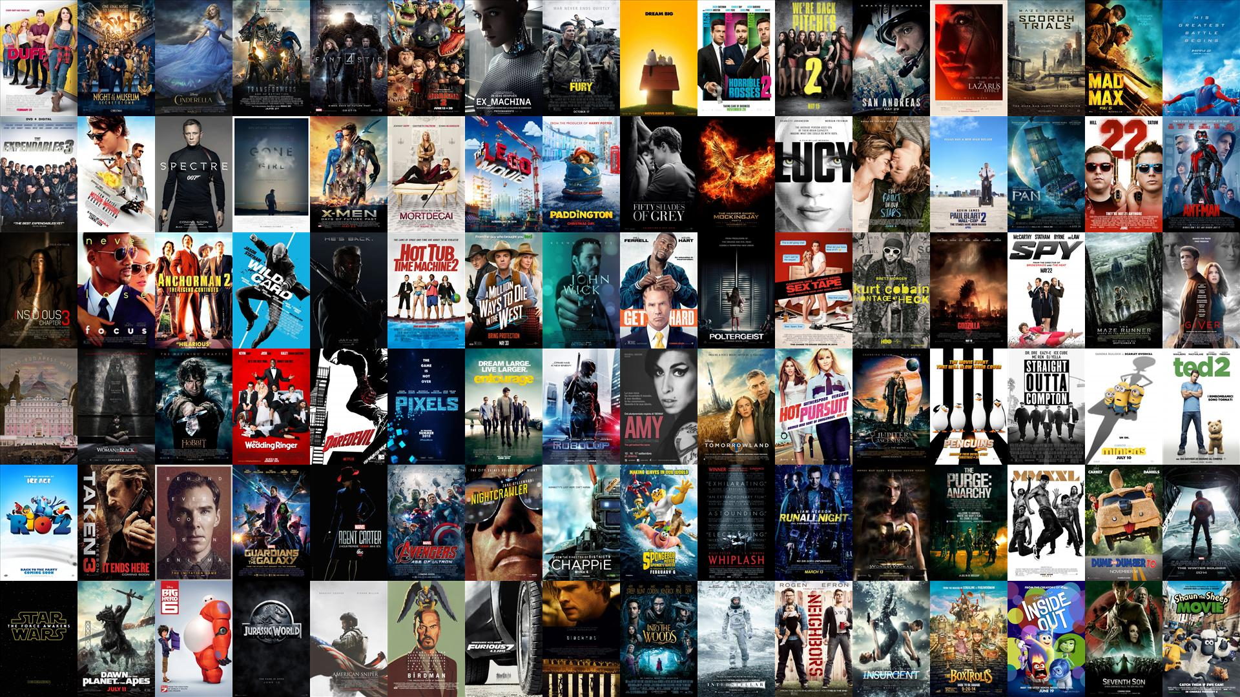

Predicting Movie Genre through Traditional Machine Learning and Deep Learning
Notes:
In this project, we predict movie genres using traditional machine learning and deep learning

Slide 2
Data
Connected to IMDB and TMDB databases through APIs and gathered data for 4444 movies including posters. Merged data from both sources through IMDB ids.
TMDB Data Fields
Adult:
Budget:
Genres
Homepage:
Id:
imdb_id:
original_language
original_title
Overview
Popularity
poster_path:
IMDB Data Fields
Director
Cast
writer:
rating:
votes:
runtimes:
Genres
production_companies:
production_countries:
release_data:
Revenue:
Runtime:
spoken_language
Status
Tagline:
Title:
vote_average:
vote_count
Notes:
We extract data from IMDB and TMDB databases and merge them to meta data We have a number of features: title, overview, cast, director, writers and so on.

Slide 3

Notes:
The motivation is to predict the movie genres based on the features in meta data.

Slide 4
Notes:
We can see one movie may have more than one genre, That is the first challenge we are facing

Slide 5
Challenges
Multi-label problem
Solution: Reduce to multi-class problem
Notes:
To address it, we reduce the multi-label problem to multi-class problem.

Slide 6
Challenges
Multi-label problem
Solution: Reduce to multi-class problem
Large numbers of genres
Solution: Keep genres with more than 50 movies
Notes:
The second challenge is the large number of genres, so we only keep genres with over 50 movies.

Slide 7
Challenges
Multi-label problem
Solution: Reduce to multi-class problem
Large numbers of genres
Solution: Keep genres with more than 50 movies
Unbalanced labels
Solution: Use class weighting when fitting the models
Notes:
The following challengeis the Unblanced labels. We weight classes in modeling to address it.

Slide 8
Challenges
Multi-label problem
Solution: Reduce to multi-class problem
Large numbers of genres
Solution: Keep genres with more than 50 movies
Unbalanced labels
Solution: Use class weighting when fitting the models
Weak correlation between genres and meta data
Solution: Use image recognition of posters and natural language processing of plot summaries
Notes:
The last challenge is the weak correlation between response and predictors. We incorporate poster image and NLP to improve the prediction.

Slide 9
Traditional Machine Learning: Scheme 1
Metadata
Plot Summary/Title
Vectorized bag of words
Clean & process
PCA
Traditional Machine Learning Algorithms
Notes:
For traditional machine learing, we have two Schemes. In scheme 1 we combine meta data and text data and reduce dimention using PCA.

Slide 10
Traditional Machine Learning Scheme 1
Notes:
Compared the prediction accuracies. It turns out that Random Forest performs the best, but only slightly better than other models.

Slide 11
Traditional Machine Learning: Scheme 2
Plot Summary/Title
Remove PCA!
Tf-Idf
Chi2 pre-screen
Traditional Machine Learning
Accuracy ~46%
Notes:
In scheme 2, we extract TFIDF features from movie overview and remove the PCA step. Reach about 46% accuracy

Slide 12
Notes:
We also use deep learning to analyze poster images.

Slide 13
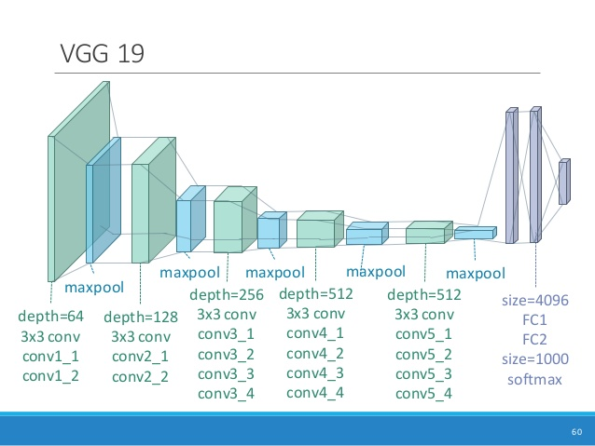
Use pre-trained VGG19 deep learning model for predicting genre through movie posters
Notes:
We used pre-trained VGG19 model from imagenet.

Slide 14
VGG19 CNN – Modification and Hyper-parameter tuning
Notes:
We adjust the model and reach a top accuracy 37%.

Slide 15
Final Model Structure
Plot Summary/Title
Metadata
Poster Data
Logistic Regression
Random Forest
Pre-Trained VGG19 CNN
Prediction
(Accuracy : 46%)
Prediction
(Accuracy : 20%)
Prediction
(Accuracy : 37%)
Model Ensembling
(Weighted Probabilities)
Final Prediction
(Accuracy : 47.2%)
Notes:
Finally, we combine different models we used in an ensemble prediction,

Slide 16
Final Model Structure
Plot Summary/Title
Metadata
Poster Data
Logistic Regression
Random Forest
Pre-Trained VGG19 CNN
Prediction
(Accuracy : 46%)
Prediction
(Accuracy : 20%)
Prediction
(Accuracy : 37%)
Model Ensembling
(Weighted Probabilities)
~47%
Final Prediction
(Accuracy : 47.2%)
Notes:
The final accuracy is about 47%.

